Slide 1
Plumas County Bird Observation Study
Dr. Busybody
University of California, Merced
Invited Talk: International Ornithological Union
drbbody@ucmerced.edu

Slide 2
Introduction
Plumas County, CA
5 Main Species (Common Names)
Dark-eyed Junco
Western Tanager
Yellow-Rumped Warbler
Hermit Warbler
Red-breasted Nuthatch
Strong correlation between elevation and species
No connection between observed distance and species
No correlation for Observation Distance as a function of Elevation

Slide 3
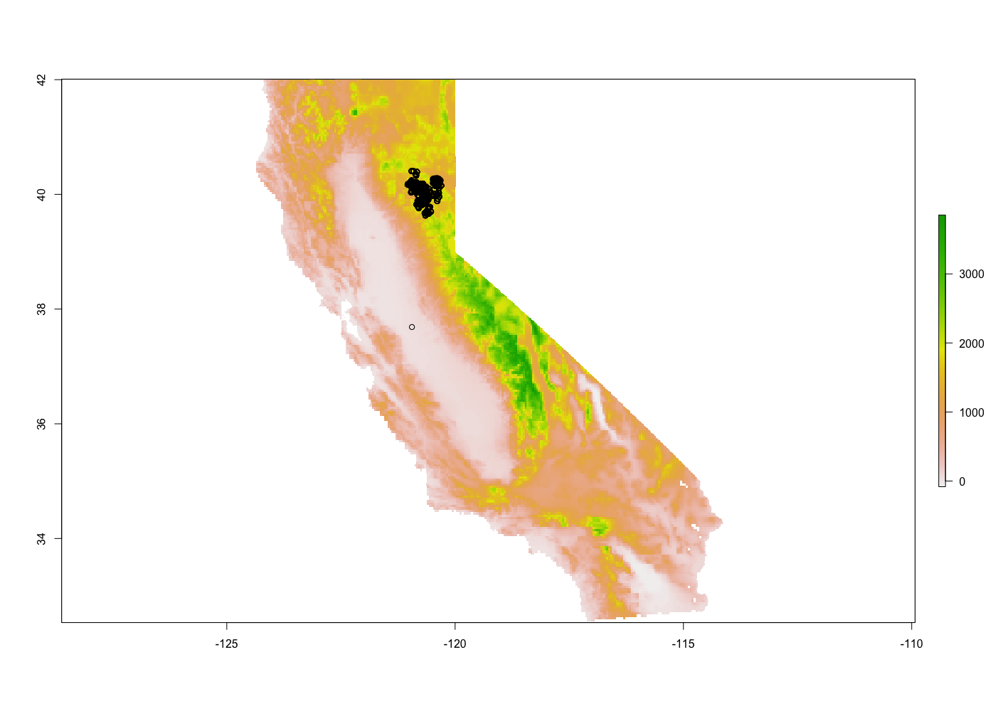
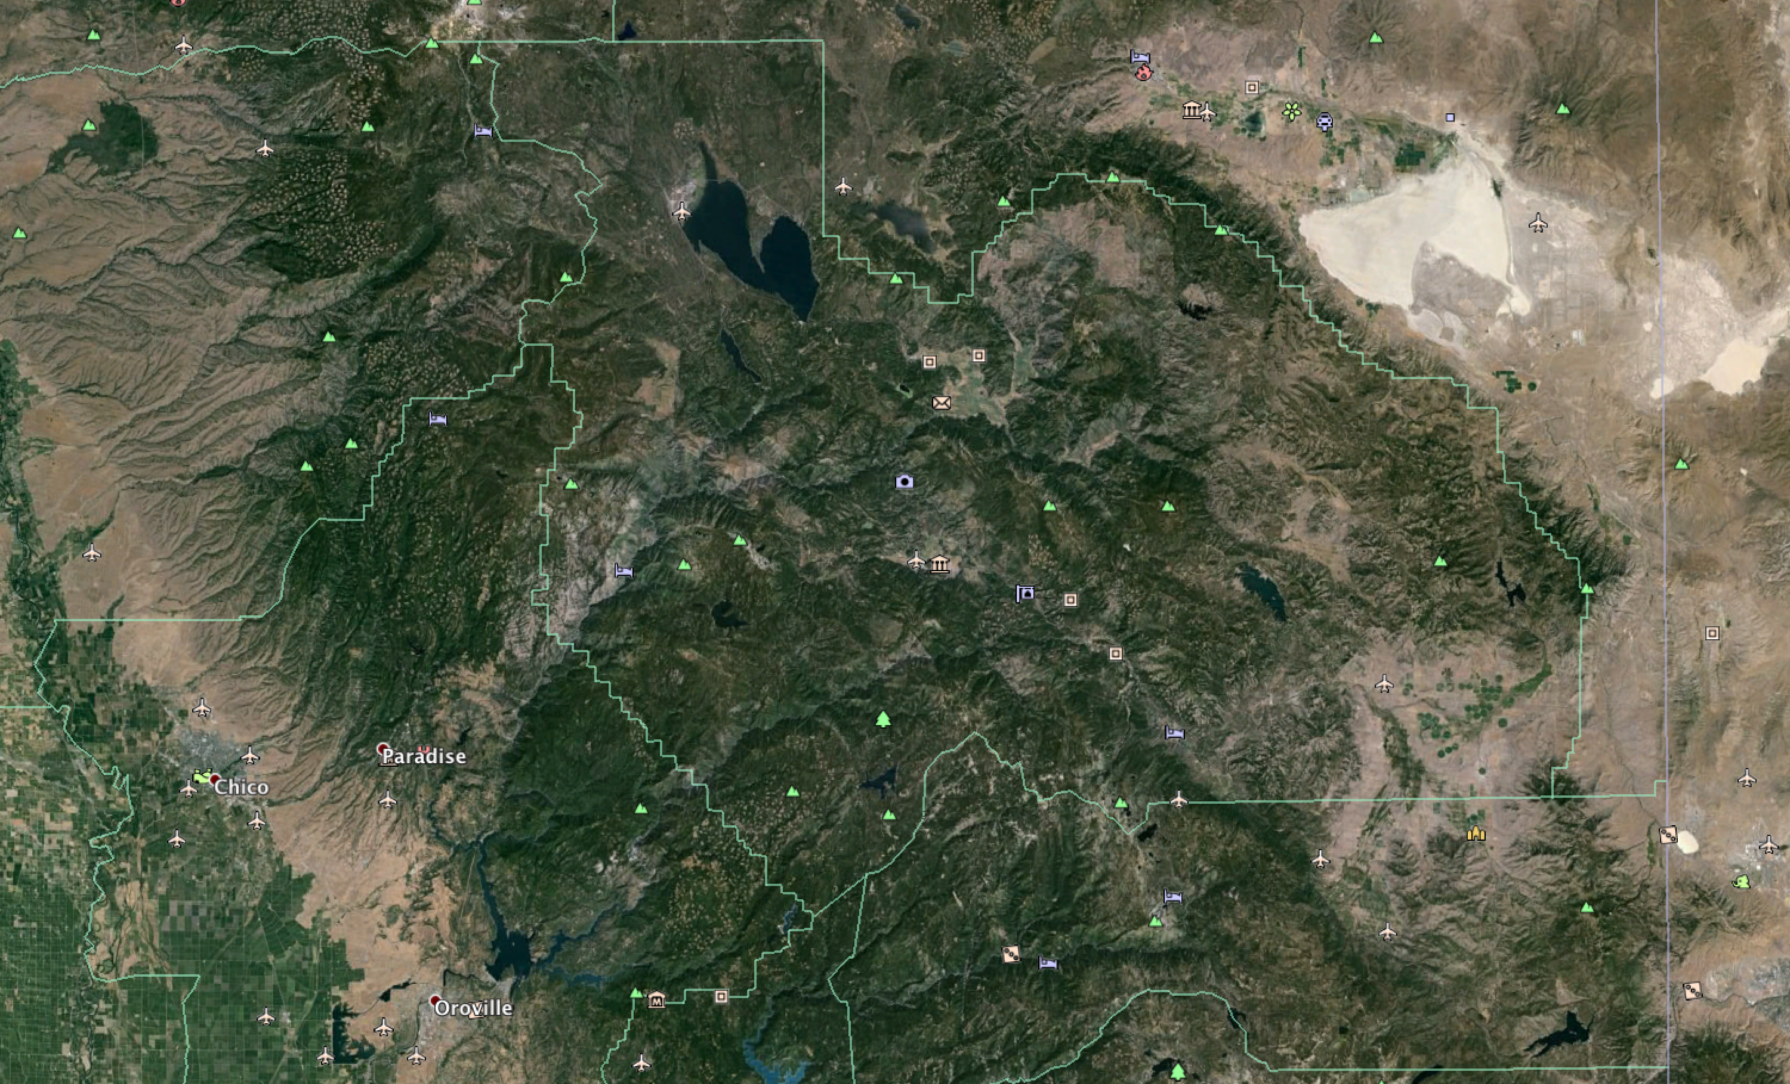
Study Area Plumas County, CA
Google Earth Image
Digital Elevation Model
Species identification location plotted with black circles

Slide 4
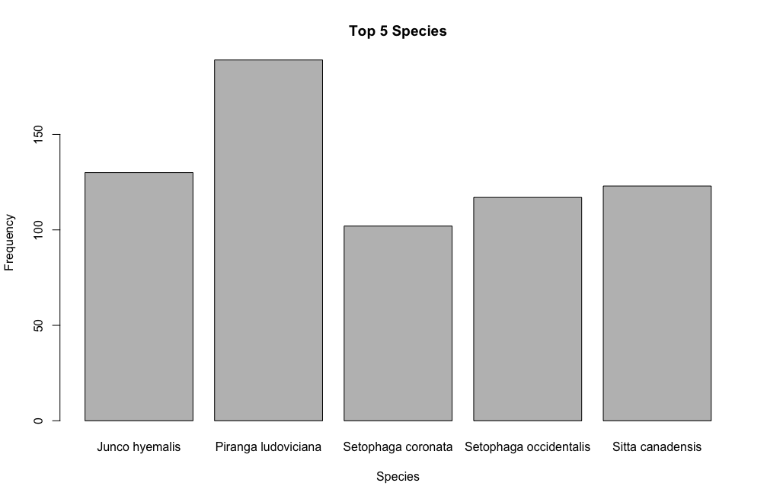
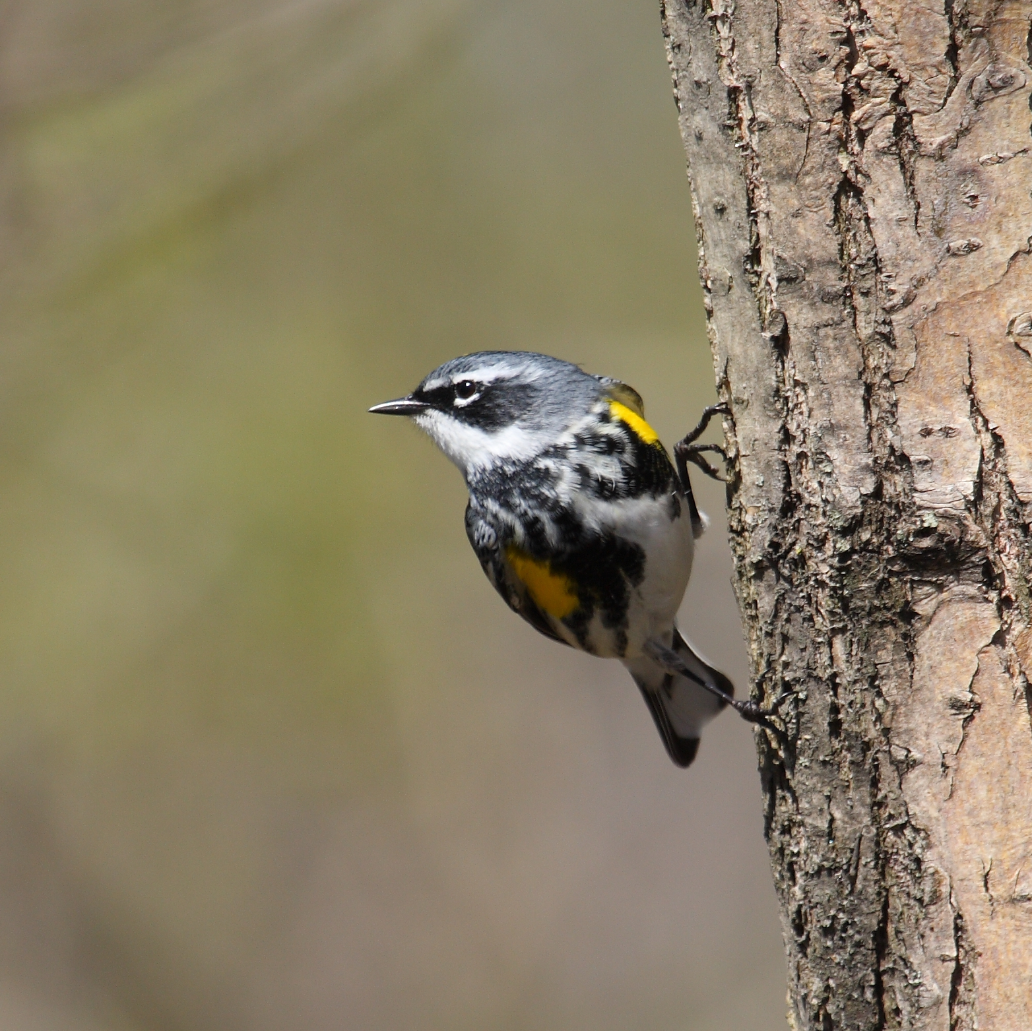
Ranked Histogram
Notes:
Junco Hyemalis – Dark-eyed Junco - https://c1.staticflickr.com/3/2709/4452654426_1f78fc9e55_z.jpg?zz=1
Piranga ludoviciana – Western Tanager - http://cdn4.pacifichorticulture.org/wp-content/uploads/2011/01/Wigand.06.019.jpg
Setophaga coronata – Yellow-Rumped Warbler - https://upload.wikimedia.org/wikipedia/commons/3/30/Setophaga_coronata_DM.jpg
Setophaga occidentalis – Hermit Warbler - https://s-media-cache-ak0.pinimg.com/736x/68/65/6d/68656def79485376a4b2bd711b277731.jpg
Sitta Canadensis – Red-breasted Nuthatch - http://www.almac.ca/jays_kinglets/2060_Red-breasted_Nuthatch.jpg

Slide 5
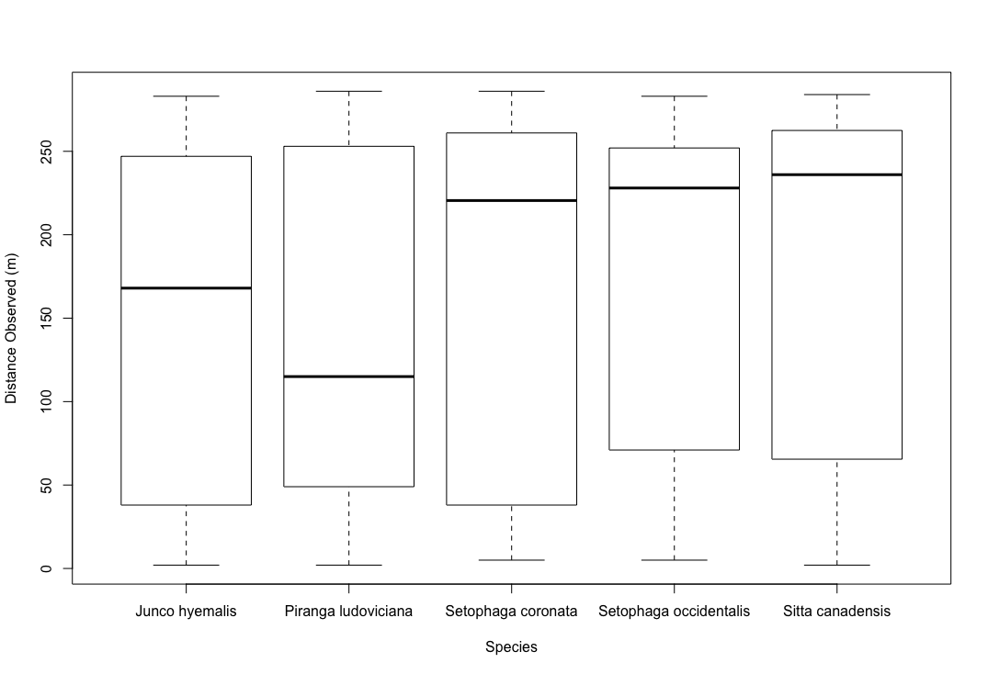
Observed Distance
Most Species are identified at 100m or greater
There is a large amount of variability in the distance observed
Not a normal distribution
Log or power law

Slide 6
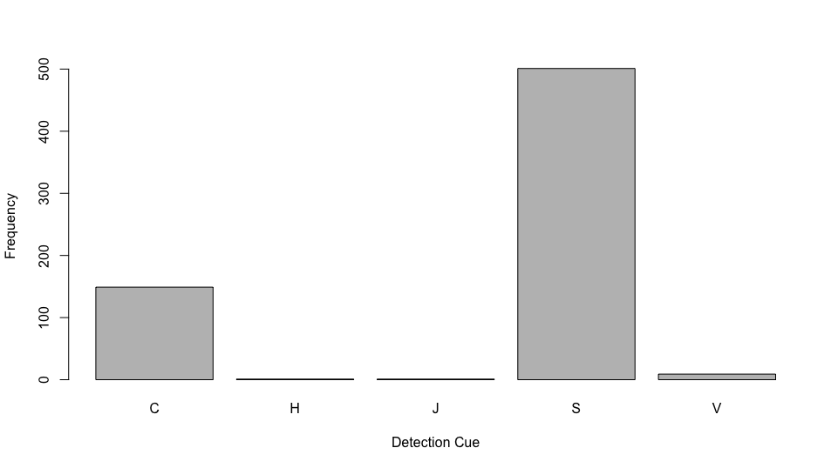
Detection Cue
Two Main Cues:
Song
Call
“S" for song
"V" for visual
"C" for call
“D” for drumming woodpecker
“H” for humming hummingbird
”J” for Juvenile
Notes:
"There two main detection cues seen during this study, that is Song (#1) and Call (#2)

Slide 7
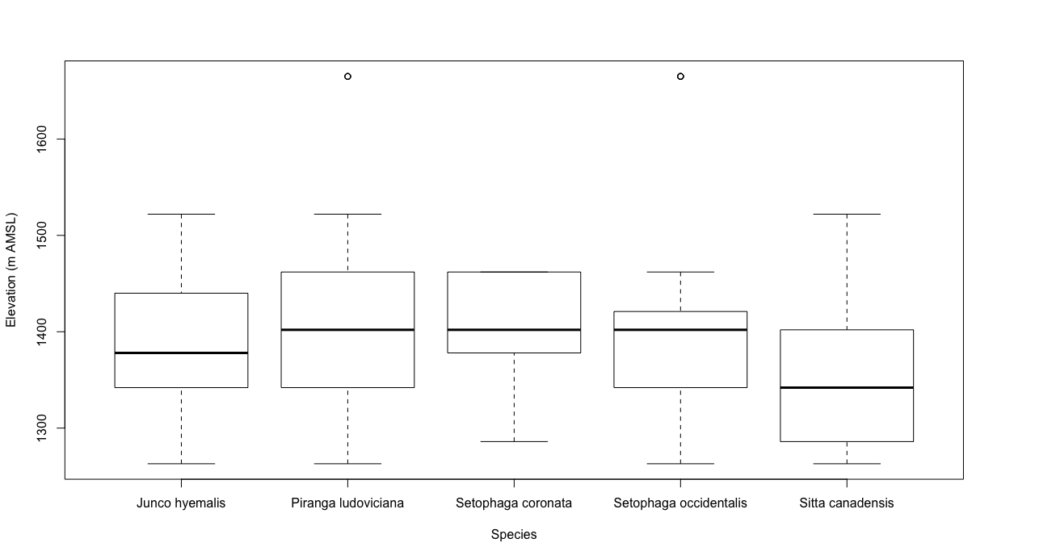
Elevation at Observation
Species tend to be normally distributed around a specific elevation
Notes:
We can see a strong relationship between species observation and elevation.
Elevation data was extracted from DEM.tif provided in assignment 5. I attempted to download higher resolution DEM models online, but couldn’t figure it out

Slide 8
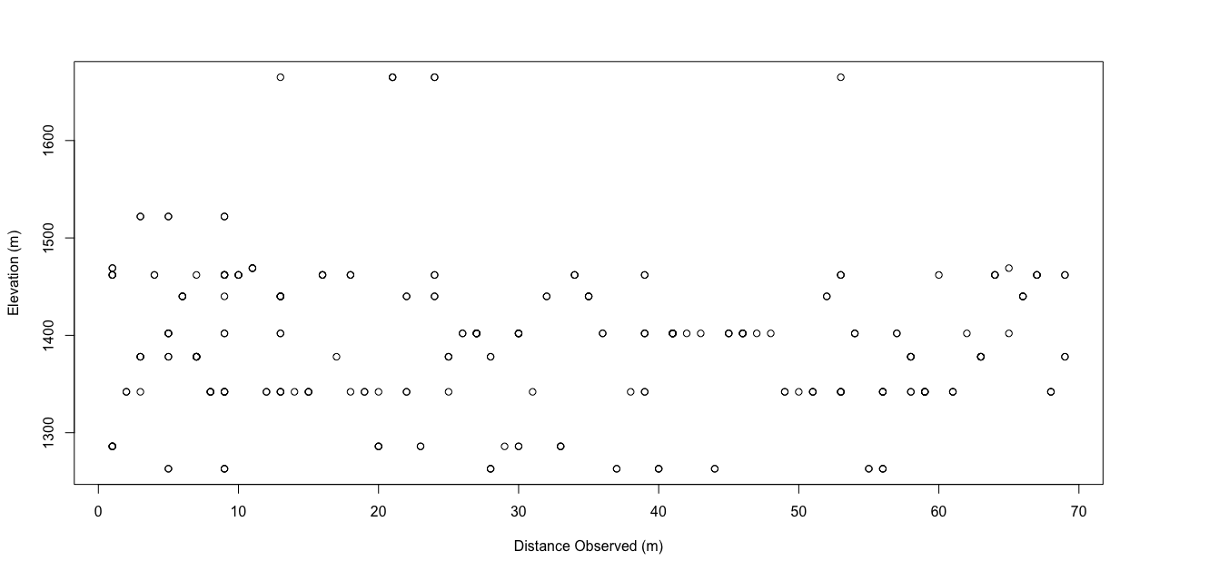
Distance Observed vs. Elevation
Linear Model Results:
Distance Observed~Elevation
Adjusted R-squared: 0.005306
p-value: 0.1158
No correlation

Slide 9
Conclusion
There is a strong connection between the observation of a specific species at a specific elevation, within a normal distribution of that height
There is no connection between elevation and observable height
A majority of the detection cues are audible, with song being number one

